Slide 1

Machine Learning for Engineers: Principal Component Analysis (PCA)
Mina Farmanbar
Associate Professor, University of Stavanger
for engineers

Slide 2
Principal component analysis (PCA)
Principal component analysis is a popular unsupervised Machine Learning technique for reducing the dimensionality of large data sets.
It finds a smaller set of features, called principal components (PCs), that capture most of the information from the original data.

Slide 3
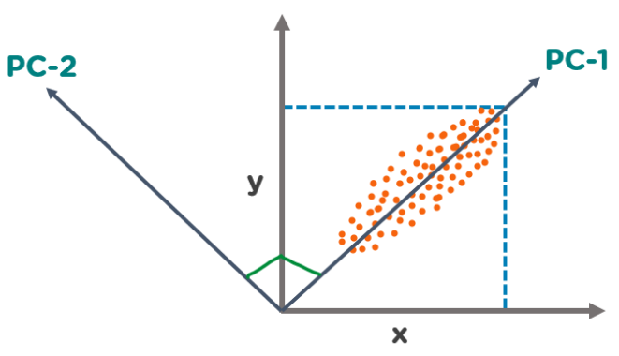
What Are Principal Components?
We have several points plotted on a 2-D plane.
There are two principal components.
PC1 is the primary principal component that explains the maximum variance in the data.
PC2 is another principal component that is orthogonal to PC1.
https://www.simplilearn.com/ice9/free_resources_article_thumb/PrincipalComponents.PNG

Slide 4
Step-by-Step Guide to PCA
How to find principal components mathematically?
Step-by-Step Guide to PCA

Slide 5
Step 1: Data preparation and Standardization
Data collection: Gather the dataset you want to analyze using PCA.
Data cleaning: Handle missing values and outliers if necessary.
Data normalization: Standardize the data with a mean of 0 and a standard deviation 1 across features.

Slide 6
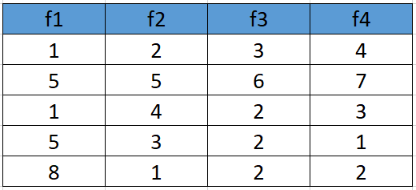
Step 1: Data preparation and Standardization
Assume we have the below dataset which has 4 features and a total of 5 training examples.

Slide 7
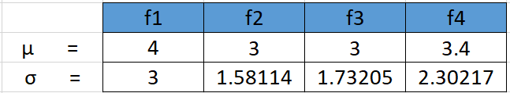

Step 1: Data preparation and Standardization
First, we need to standardize the dataset and for that, we need to calculate the mean and standard deviation for each feature.
$$σ= \sqrt{\frac{\sum{{(x_{i}−\overline{x} )}^{2}}}{n−1}}$$

Slide 8
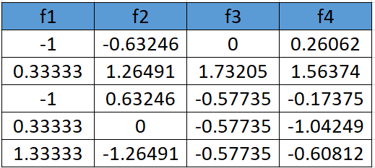

Step 1: Data preparation and Standardization
After applying the formula for each feature in the dataset is transformed as below:
$$x_{new}=\frac{x−μ}{σ}$$

Slide 9
Step 2: Covariance matrix calculation
Calculate the covariance matrix of the standardized data.
The covariance matrix indicates the relationships between different features in the dataset.

Slide 10
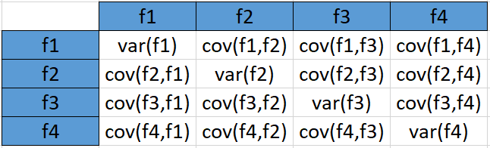

Step 2: Covariance matrix calculation
The formula to calculate the covariance matrix:
$Cov(x,y)$= $\frac{\sum{((x_{i}}−\overline{x})×\left(y_{i}−\overline{y}\right))}{N}$
The covariance matrix for the given dataset will be calculated as:
Variance refers to the spread of a data set around its mean value
Covariance refers to the measure of the directional relationship between two variables

Slide 11
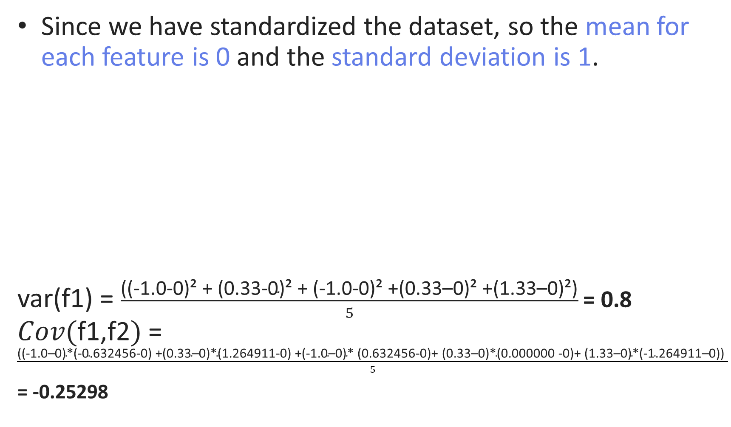
Step 2: Covariance matrix calculation
Since we have standardized the dataset, so the mean for each feature is 0 and the standard deviation is 1.
var(f1) = $\frac{\text{((−1.0−0)² + (0.33−0)² + (−1.0−0)² +(0.33–0)² +(1.33–0)²)}}{5}$ = 0.8 $Cov(\text{f}\text{1,}\text{f}\text{2})$= $\frac{\text{((−1.0–0)∗(−0.632456−0) +(0.33–0)∗(1.264911−0) +(−1.0–0)∗ (0.632456−0)+ (0.33–0)∗(0.000000 −0)+ (1.33–0)∗(−1.264911–0)) }}{5}$
= -0.25298

Slide 12
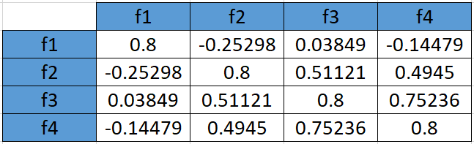
Step 2: Covariance matrix calculation
In the similar way we can calculate the other covariances:

Slide 13
Step 3: Eigenvector and eigenvalue calculation
Compute the eigenvectors and eigenvalues of the covariance matrix.
Eigenvectors:
Represent the directions of the new feature space.
Eigenvalues:
Indicate the magnitude of variance explained by each eigenvector.

Slide 14


Step 3: Eigenvector and eigenvalue calculation
$$det⁡(A−λI) = 0$$
Solving the above equation:
λ = 2.51579324 ,
λ = 1.0652885 ,
λ = 0.39388704 ,
λ = 0.02503121

Slide 15
Step 4: Sorting eigenvalues
Sort the eigenvalues in descending order.
***This step helps select the principal components that capture the most variance in the data.
Since eigenvalues are already sorted in this case so no need to sort them again.

Slide 16
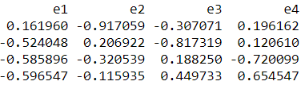
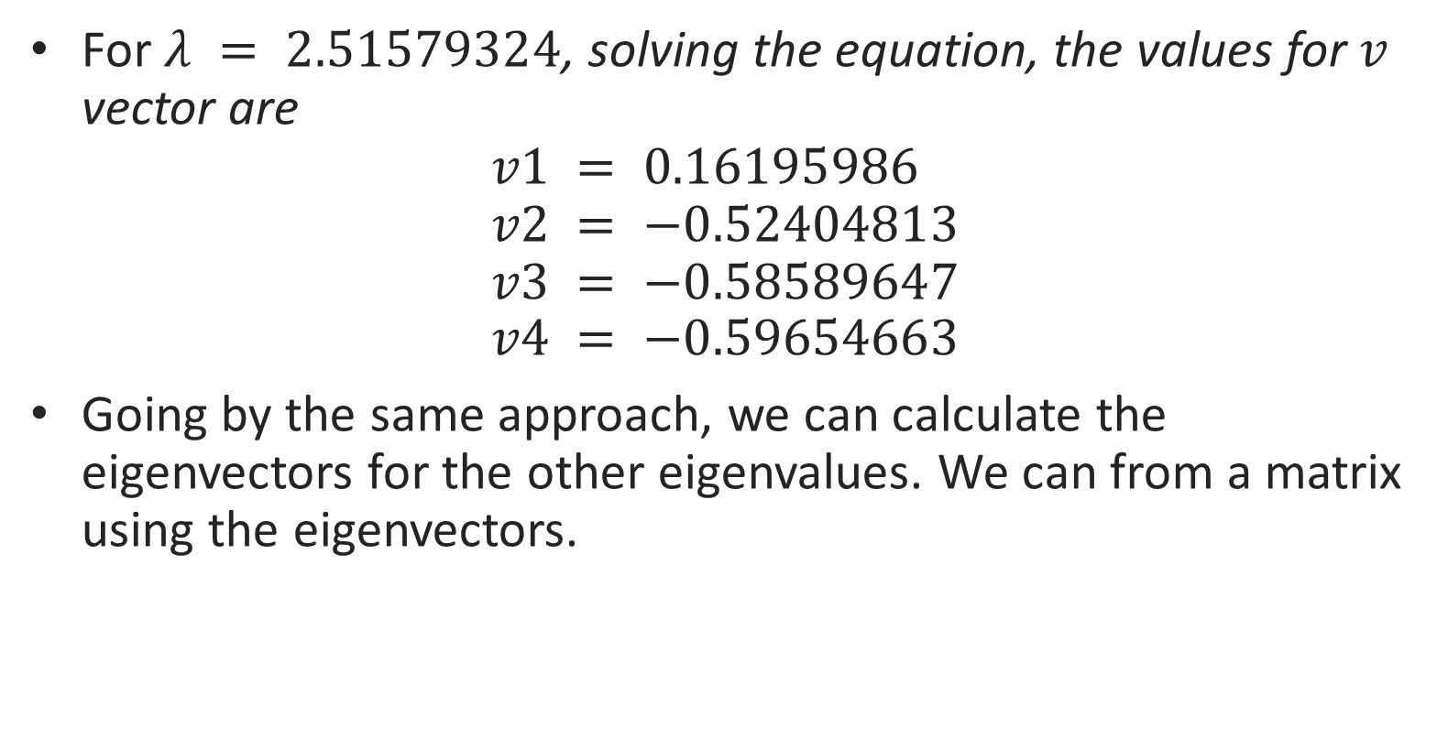
Step 3: Eigenvector and eigenvalue calculation
For $λ = 2.51579324$, solving the equation, the values for $v$ vector are
$$v1 = 0.16195986 \\ v2 = −0.52404813 \\ v3 = −0.58589647 \\ v4 = −0.59654663$$
Going by the same approach, we can calculate the eigenvectors for the other eigenvalues. We can from a matrix using the eigenvectors.
eigenvectors(4 * 4 matrix)

Slide 17
Step 5: Constructing the projection matrix
Select the top k eigenvectors corresponding to the k largest eigenvalues.
These eigenvectors form the projection matrix.

Slide 18
Step 5: Constructing the projection matrix
If we choose the top 2 eigenvectors, the matrix will look like this:
e1 | e2
0.1619 | -0.9170
-0.5240 | 0.2069
-0.5858 | -0.3205
-0.5965 | -0.1159
Top 2 eigenvectors(4*2 matrix)

Slide 19
Step 6: Projecting data onto new feature space
Multiply the standardized data by the projection matrix to obtain the new feature space.
The new feature space consists of principal components.

Slide 20
Step 6: Projecting data onto new feature space
Feature matrix * top k eigenvectors = Transformed Data
nf1 | nf2
0.0140 | 0.7559
-2.5565 | -0.7804
-0.0514 | 1.2531
1.0141 | 0.0002
1.5798 | -1.2289
e1 | e2
0.1619 | -0.9170
-0.5240 | 0.2069
-0.5858 | -0.3205
-0.5965 | -0.1159
*
=
Data Transformation

Slide 21
Thank you
Mina Farmanbar
mina.farmanbar@uis.no

